Slide 1
Designing Use Case Diagram of a Clinic (TogetherSoft Inc.)
Supervised by:
Mr. Samrat Kumar Dey Assistant Professor (Computer Science and Engineering)
School of Science and Technology
Bangladesh Open University
Presented by :
Md. Zubaer Ahammed
ID: 20052801006
Dept of CSE
School of Science and Technology
Bangladesh Open University

Slide 2
Introduction
This presentation illustrating the "Designing Use Case Diagram of a Clinic" using EdrawMax or Equivalent software.
This diagram will illustrate the various interactions between actors and the system, helping to understand the functionality and behavior of the system.
UML (Unified Modeling Language) is a standardized modeling language used in software engineering for visualizing, specifying, constructing, and documenting software systems.
A Use Case Diagram in UML represents the interactions between external actors (users) and the system to achieve specific goals. It illustrates the functionalities of a system from the user's perspective.

Slide 3
Use Case Diagram
A use-case diagram is a set of use cases
A use case is a model of the interaction between
External users of a software product (actors) and
The software product itself
More precisely, an actor is a user playing a specific role
describing a set of user scenarios
capturing user requirements
contract between end user and software developers

Slide 4
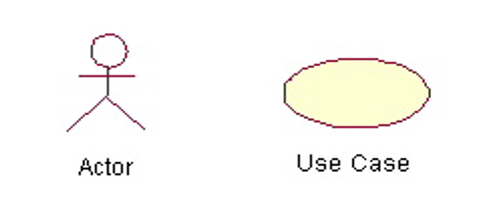
Use Case Diagram
Actors: A role that a user plays with respect to the system, including human users and other systems. e.g., inanimate physical objects (e.g. robot); an external system that needs some information from the current system.
Use case: A set of scenarios that describing an interaction between a user and a system, including alternatives.
System boundary: rectangle diagram representing the boundary between the actors and the system.

Slide 5

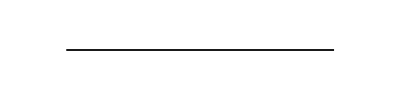
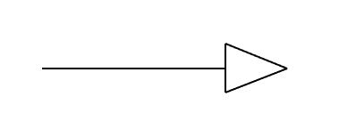
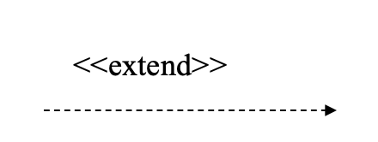
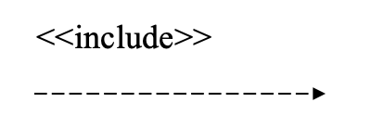
Use Case Diagram
Association: communication between an actor and a use case; Represented by a solid line.
Generalization: relationship between one general use case and a special use case (used for defining special alternatives) Represented by a line with a triangular arrow head toward the parent use case.
Association: a dotted line labeled <<include>> beginning at base use case and ending with an arrows pointing to the include use case. The include relationship occurs when a chunk of behavior is similar across more than one use case. Use “include” in stead of copying the description of that behavior.
Extend: a dotted line labeled <<extend>> with an arrow toward the base case. The extending use case may add behavior to the base use case. The base class declares “extension points”.

Slide 6
Procedure
Open EdrawMax or equivalent software.
Select the option to create a new UML diagram.
1. Identify Actors:
Determine the primary actors interacting with the system. In a clinic management system, actors could include patients, doctors, receptionists, and administrators.
2. Identify Use Cases:
Define the functionalities the system should perform to meet the needs of its users. Use cases for a clinic management system may include scheduling appointments, managing patient records, prescribing medication, billing, etc.

Slide 7
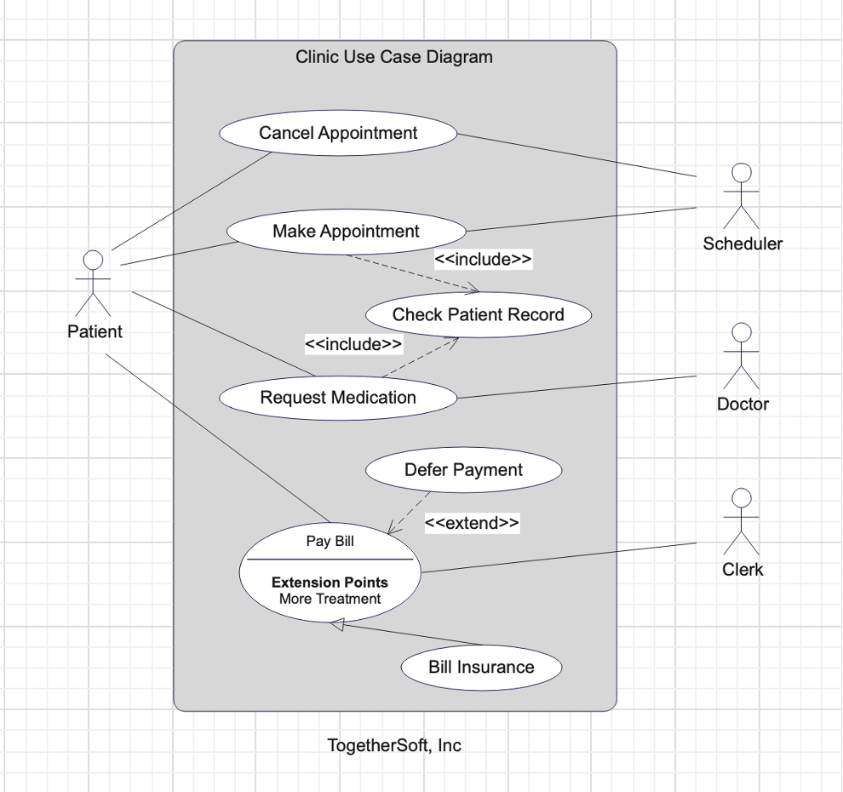
3. Draw Use Case Diagram:
Use eDrawMax or any equivalent software to create the UML Use Case Diagram.
Start by drawing a box representing the system boundary.
Inside the boundary, place actors (represented by stick figures) and use cases (represented by ovals).
Connect actors to the use cases they participate in with solid lines, indicating associations or interactions.
Add multiplicity if an actor participates in multiple instances of a use case.
Include include-extends relationships if certain use cases extend others.
Both Make Appointment and Request Medication include Check Patient Record as a subtask (include)
The extension point is written inside the base case Pay bill; the extending class Defer payment adds the behavior of this extension point. (extend)
Pay Bill is a parent use case and Bill Insurance is the child use case. (generalization)
Finally, refine, validate and save.

Slide 8
Conclusion
In conclusion, designing a UML Use Case diagram of the General Problem Solution Approach provides a structured framework for effectively addressing and solving problems.
By following the defined steps, individuals and organizations can streamline their problem-solving process, leading to more efficient and successful outcomes.
Utilizing software such as EdrawMax facilitates the visualization and documentation of the problem-solving process, enabling clear communication and collaboration among stakeholders.
Overall, the flowchart serves as a valuable tool for guiding problem-solving efforts and driving continuous improvement.

Slide 9

THANK YOU

